Slide 1


Introduction to Data Science
Machine Learning Final Project
Course Instructors: Dr. Naama Kopelman & Dr. Jonathan Schler
Holon Institute of Technology (HIT)

Slide 2


The Team
Adi Dereviani, B.Sc. Computer Science Student
Liron Levi, B.Sc. Computer Science Student

Slide 3


Our Research Question
We want to predict the number of edits on a random Wikipedia page based on categorical numerical features that can be created from the Page.
In addition, we would like to examine whether it is possible to more accurately predict whether a page will exceed a certain threshold of edits based on the same features.

Slide 4








Our Pipeline
Preprocessing
Linear Regression
KNN
Crawling
EDA
Logistic Regression
Final Evaluation

Slide 5
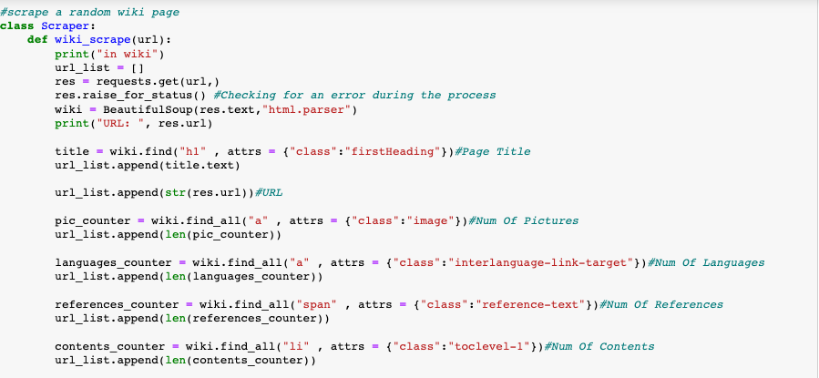

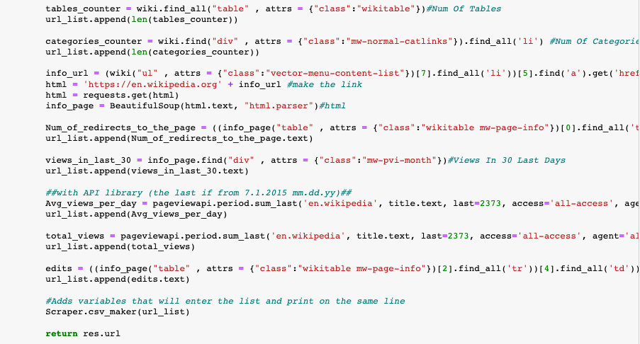
Crawling
Our data was taken randomly by
crawling from the Wikipedia site,
And with the Wikipedia API library.

Slide 6


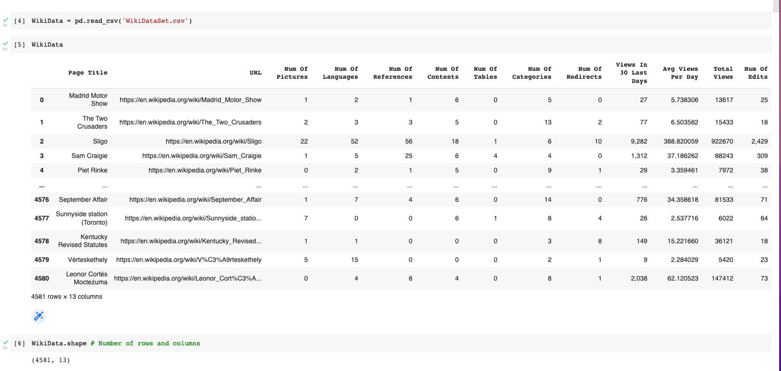
Preprocessing
Check out the Data:
we currently have
4581 rows and
13 columns.
Total of 59,553 data.

Slide 7

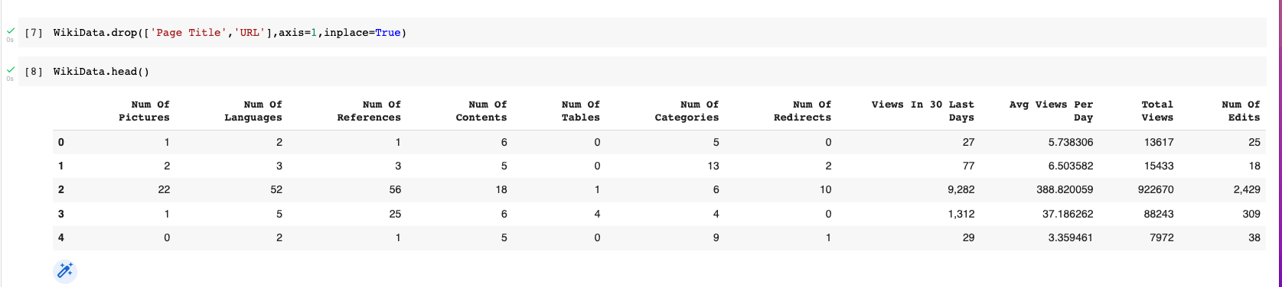
Preprocessing
We are dropping the columns that we are not going to use in our training model.
Both lines, “Page Title” and “URL” have been removed.

Slide 8
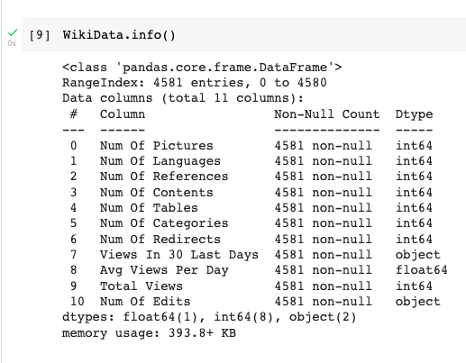

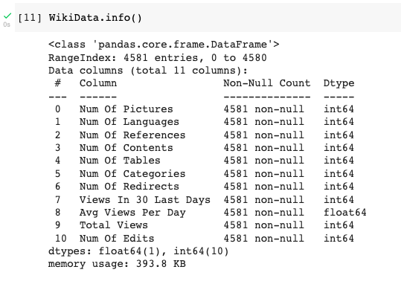
Preprocessing
Repair numeric missing values of:
“Views In 30 Last Days”, “Num Of Edits”.
As we can see, we converted numeric
objects to int64.
Finally, after the data was handled,
we were left with 4581 rows × 11 columns.
A total of 50,391 data.

Slide 9


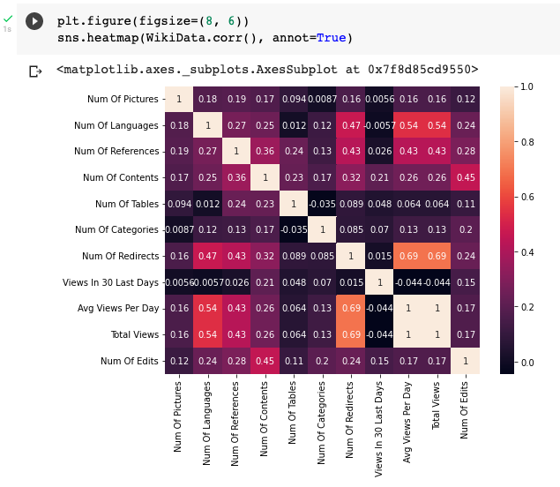
EDA
Through the EDA, we found out that we
have a perfect correlation between:
“Avg Views Per Day” and “Total Views”.
Since “Total Views” label and
“Avg Views Per Day” is two of the
X features, we will get a perfect model.
Therefore, we delete the
“Avg Views Per Day” column.

Slide 10
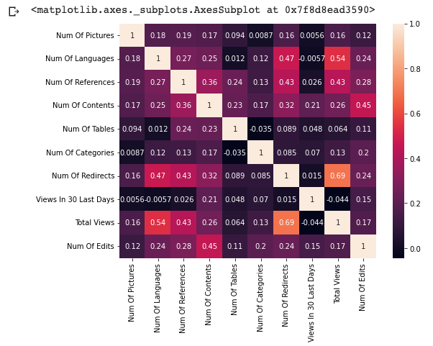
EDA
This matrix results make sense,
for example: there is high correlation
between the “Num Of Languages”
and the “Total Views” which might
suggest that the “Total Views”
increased as the page has been
translated to more languages,
which is also logical.

Slide 11

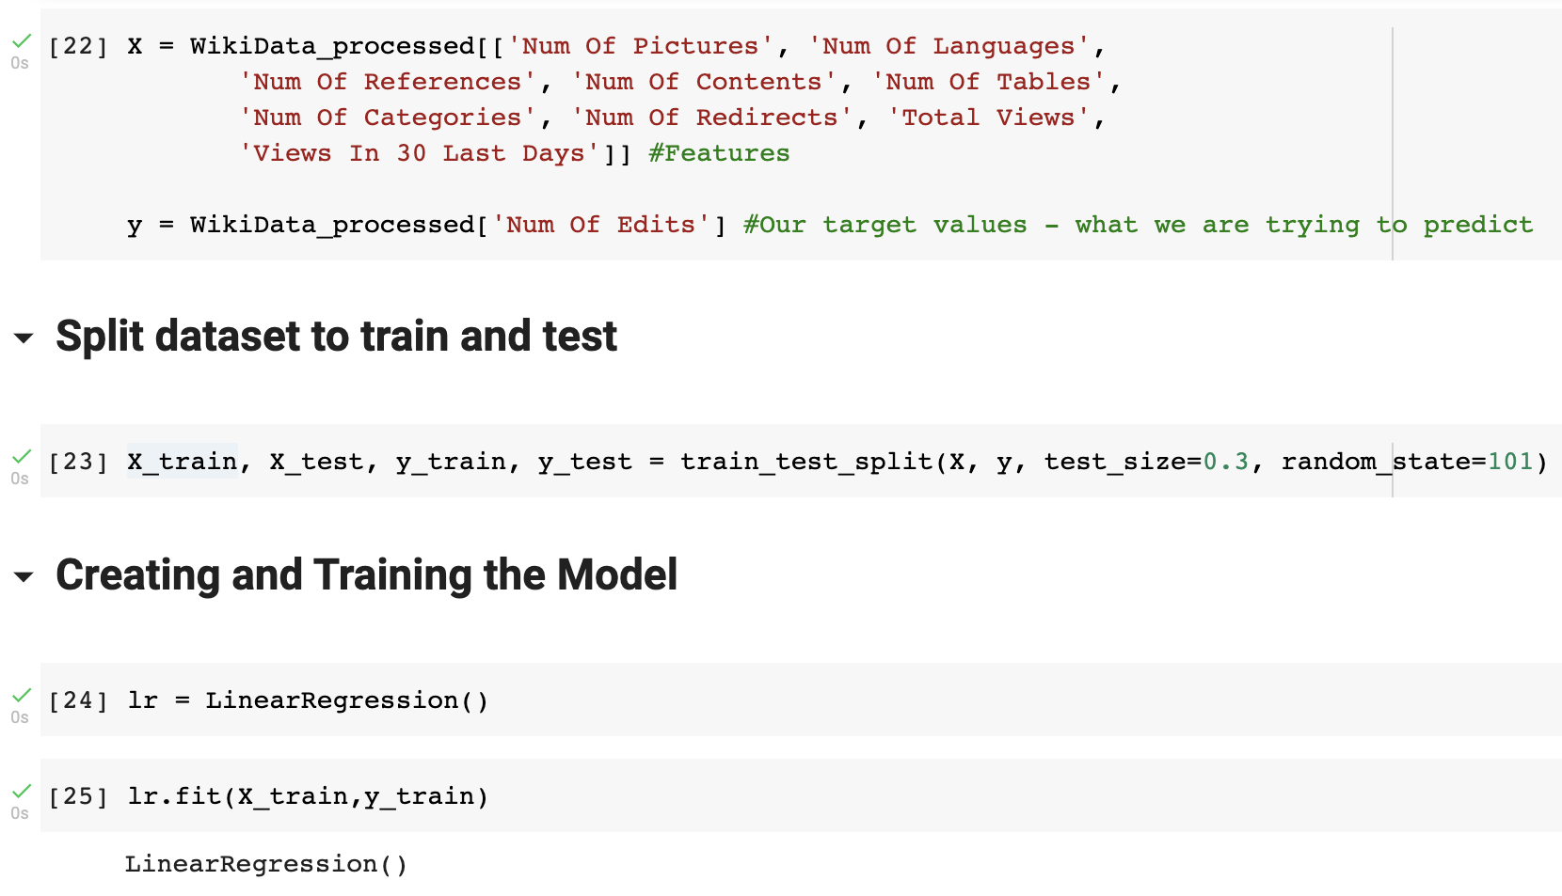
Linear Regression Model
Here we can see all the X
features, and the y we want
to predict.
Thereafter, we split the
data and train the model.

Slide 12
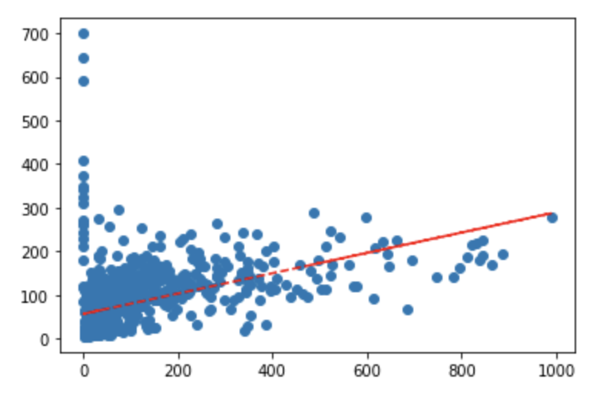

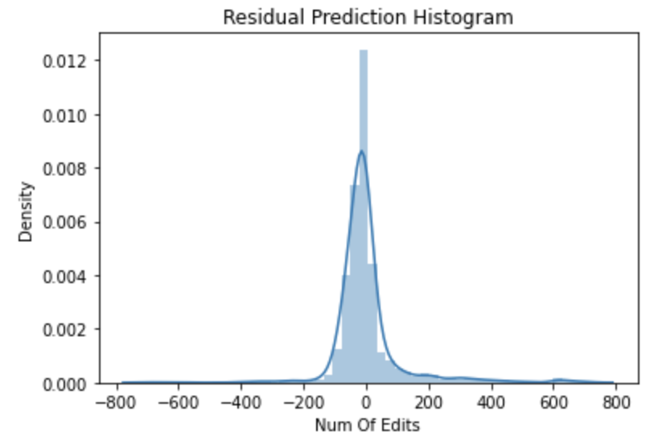
Linear Regression Model
Predictions from our Model:
We want to know how far off are the
predictions from the tests edits the actual edits.
The Residual Prediction Histogram mean is
around zero, which suggest the model manage
to predict accurately.

Slide 13

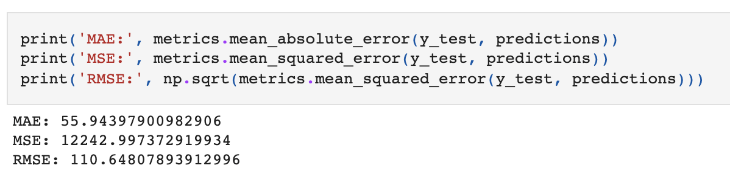
Regression Evaluation Metrics
Here are three common evaluation metrics for regression problems:
Mean Absolute Error (MAE) is the easiest to understand, because it's the average error.
Mean Squared Error (MSE) is more popular than MAE, because MSE "punishes" larger errors, which tends to be useful in the real world.
Root Mean Squared Error (RMSE) is even more popular than MSE, because RMSE is interpretable in the "y" units.
All of these are loss functions,
because we want to minimize them.

Slide 14

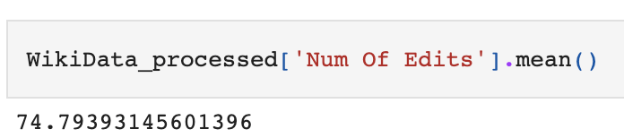
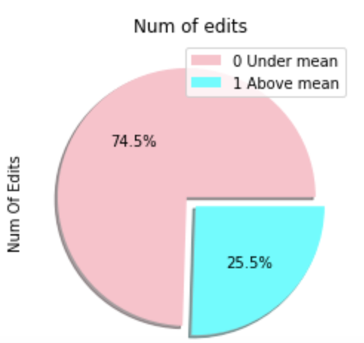
Logistic Regression Model
We check what the average of our prediction
value is.
For the y label any value above the mean (75)
will get 1 otherwise, 0.
0 → 3413
1 → 1168
As we can see, most of the observations are
below the "Numbers Of Edits" mean.

Slide 15

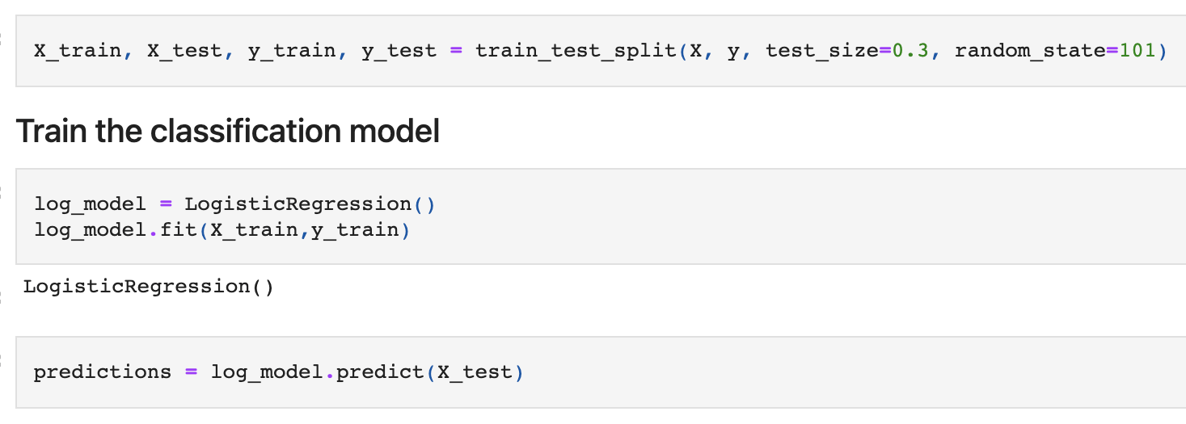
Training and Predicting
In the following image we can see that we're splitting the dataset to train and test, and train the classification model.

Slide 16

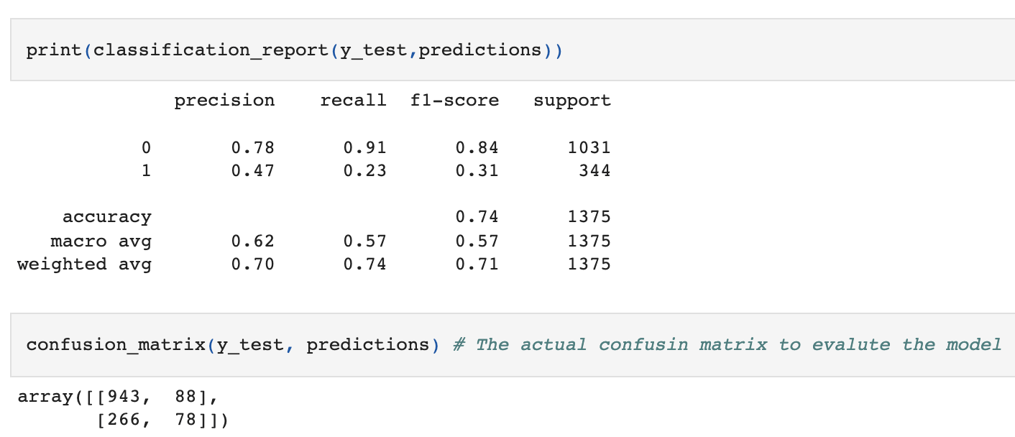
Model Evaluation
Our model was able to predict 74%.
Let's try to improve it with a KNN model.

Slide 17

KNN Model
Standardize the Variables:
Because the KNN classifier predicts the class of a given test observation by identifying the observations that are nearest to it, the scale of the variables matters.
Any variables that are on a large scale will have a much larger effect on the distance between the observations, and hence on the KNN classifier, than variables that are on a small scale.

Slide 18
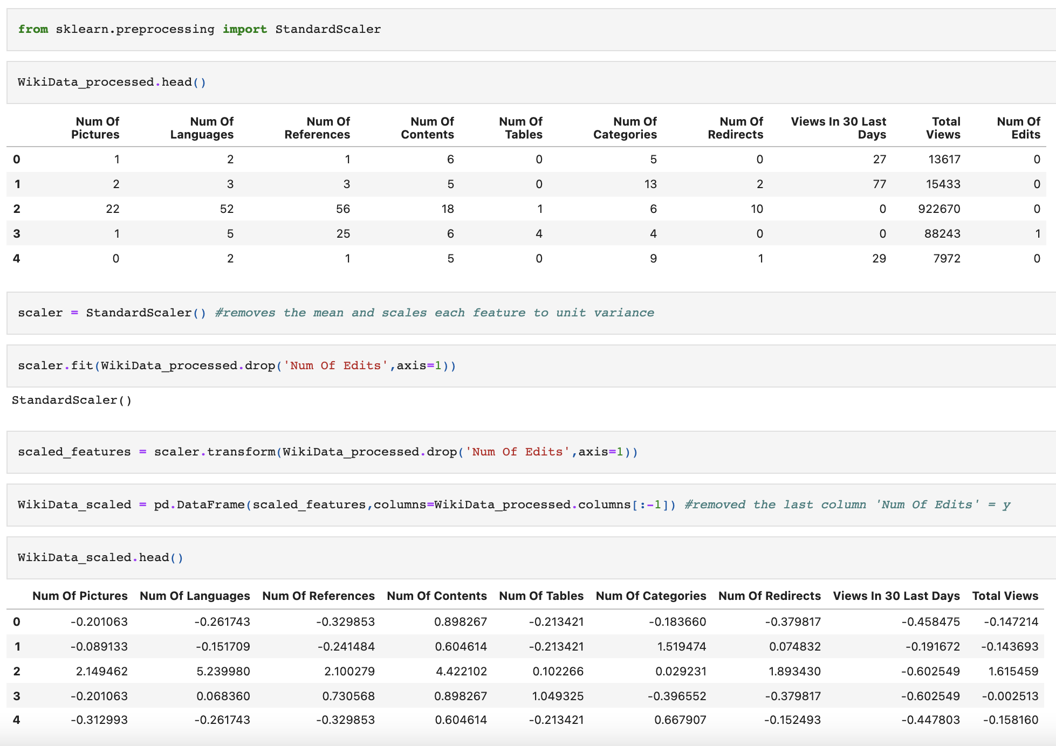
KNN Model
We are removes the mean
and scales each feature to
unit variance.
Then, we removed the
last column “Num Of Edits”,
our y label.

Slide 19

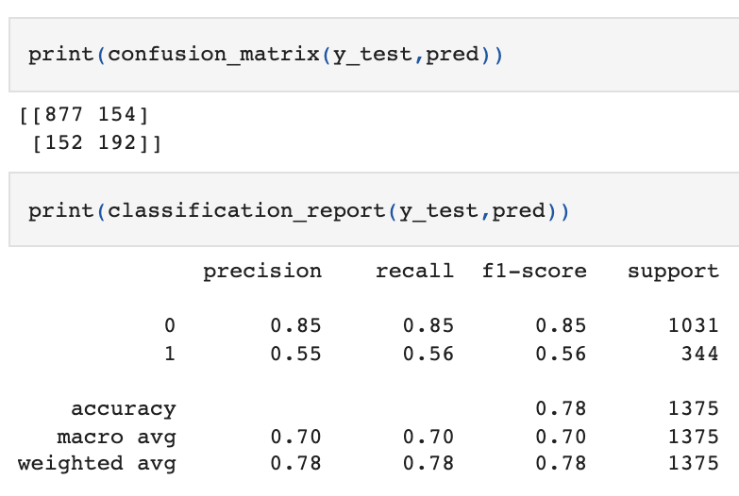
Predictions and Evaluations
Let's evaluate our KNN model.
In our initial prediction we received
“only” 78%.
Now we are going to pick a good
K Value.

Slide 20

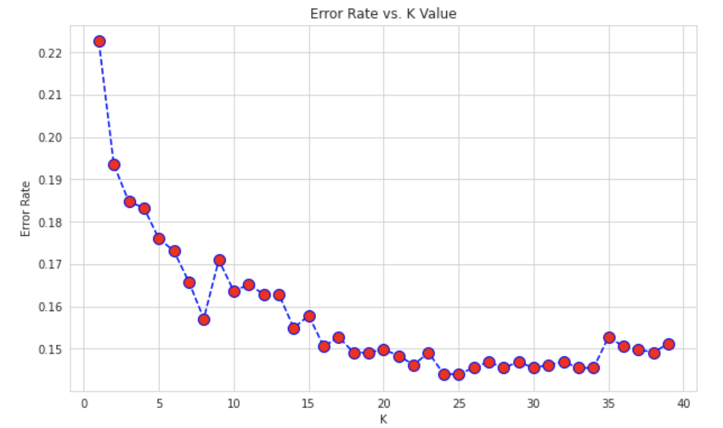
Choosing a K Value
Here we can see that
after around K>24 the
error rate just tends to
hover around 0.15 - 0.10.

Slide 21
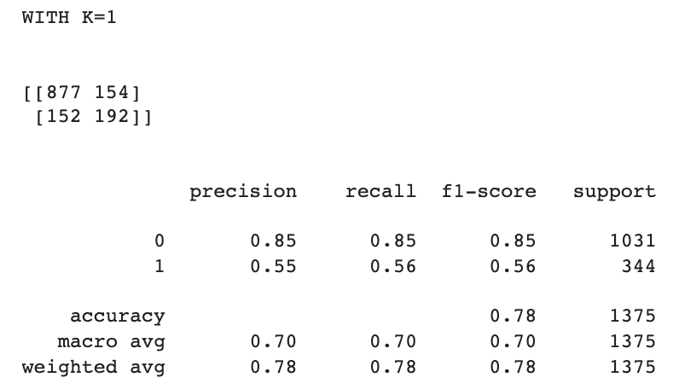

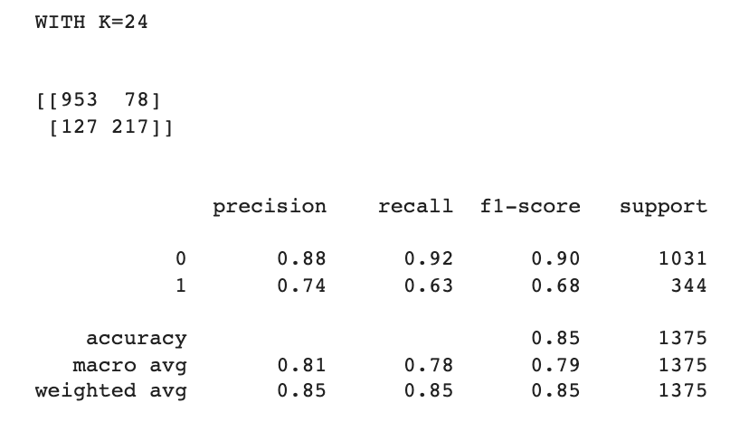

Choosing a K Value
First, a quick comparison to our original K=1:
Now with K=24:
We were able to squeeze some more performance out of our
model by tuning to a better K value!

Slide 22

Conclusions
In conclusion, in our project we used three different models: Linear regression, Logistic regression and KNN.
We were able to see that out of the classifications models, KNN was able to predict more accurately the question of our study, with a result of 85%.

Slide 23


GitHub
github.com/adidereviani/machine-learning-project-wiki

Slide 24

Thank You

